Slide 1
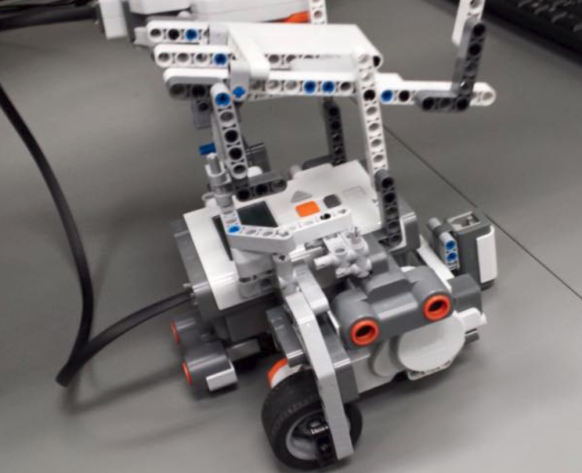
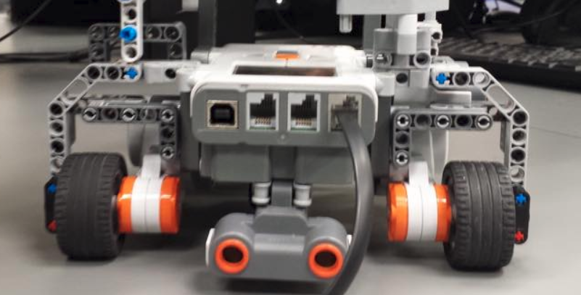
Week 4
Group 5

Slide 2
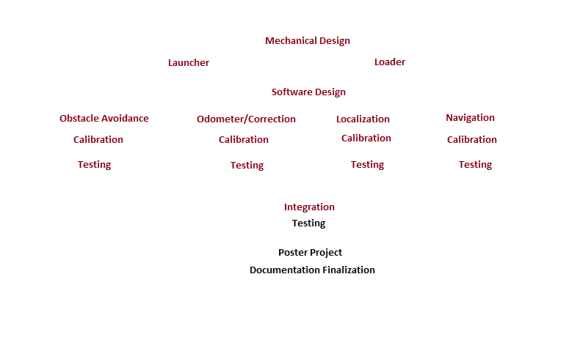
Progress report

Slide 3
Gantt chart & Documentation
Tasks Update
Poster Project
UML
LDD
Initial Documents Update

Slide 4
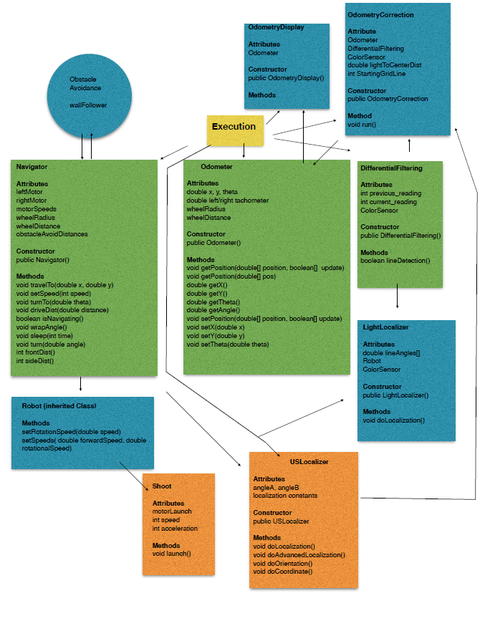
UML V2.6

Slide 5
Localization
Week 4 report

Slide 6
Localization Test V1.1
Determine which method to best determine the location of robot (rising edge or falling edge
Tie between both methods in determining orientation (Localization Test V1.0)
This test will focus on determining coordinate
Standard deviation is more important than mean

Slide 7

Results (standard deviation of error)

Slide 8
Conclusion for V1.1
Rising edge for localization method
Adjustment will be made to correct the mean for rising edge

Slide 9
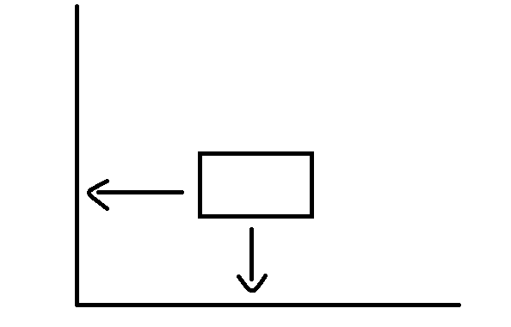
New localization method
Determine localization from finding minimums

Slide 10
Short clip
https://www.youtube.com/watch?v=xV9IVV3xIrI

Slide 11
Localization Test V2.0
Determine which method to best determine the location of robot (finding minimum or rising edge)

Slide 12
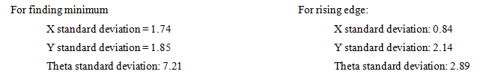
Results (standard deviation of error

Slide 13
Conclusion
Rising edge wins, but not by a lot
Light localizer to back up US localizer
Finding minimum takes significantly less time
Discussion amount team members

Slide 14
Light localization (short clip)
https://www.youtube.com/watch?v=JD9kEfJnhto&feature=youtu.be

Slide 15
Obstacle Avoidance Testing 2 (Wall Follower)
https://www.youtube.com/watch?v=JD9kEfJnhto&feature=youtu.be
Run | Normal Case | Extreme Case 1 | Extreme Case 2
1 | Pass | Pass | Pass
2 | Pass | Pass | Fail
3 | Pass | Pass | Pass
4 | Pass | Pass | Pass
5 | Pass | Pass | Pass
6 | Pass | Pass | Pass
7 | Pass | Pass | Pass
8 | Pass | Pass | Pass
9 | Pass | Pass | Pass
10 | Pass | Pass | Pass

Slide 16
Action: -Implement it
-Minor Adjustment by adding a bigger distance -Possible Pcontroller implementation prior Beta-Demo

Slide 17
Odometer Test v2.0
Compare the Odometer reading with actual distance measured by ruler
Two scenarios with 5 trials each

Slide 18
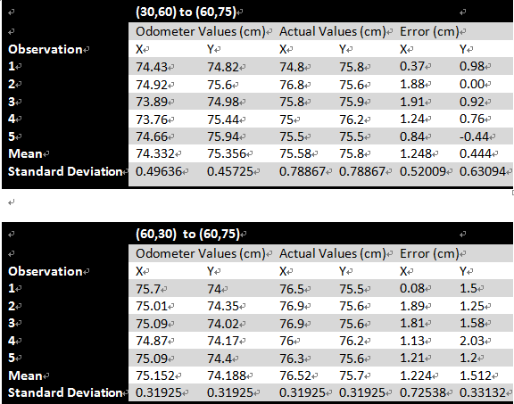
Data

Slide 19
Conclusion
Odometer test 2.0 is considered “passed”
X & Y axis errors are within +/- 1.5cm
More tests will be done in order to verify the consistency

Slide 20
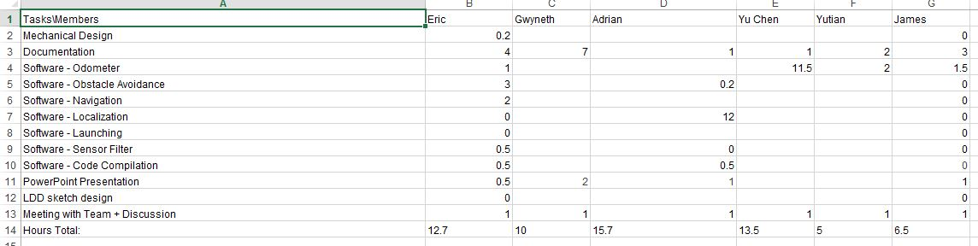
Budget

Slide 21
Plans for next week
Friday Demo
Re-Testing
Documentation
Updated list on what is left
Double check, checklist on competition requirements

